Slide 1
Introduction to SQL
brought to you by:
Kayla Thomas(Neil Bezdek, Frank Burkholder,Taryn Heilman, Jordan Hagan) Last updated by Alex Blitstein DSI

Slide 2
Objectives
Describe why we use Relational Database Management Systems (RDBMS)
Understand primary keys, foreign keys, and table relationships
Write simple SQL queries on a single table using SELECT, FROM, WHERE, GROUP BY, ORDER BY clauses as well as aggregation functions (COUNT, AVG, etc.)
Write more complex SQL queries using joins, subqueries, and temporary tables, CTEs and Views.
Learn how to use a window function
Discuss SQL best practices
Interact with a Postgres database from the command line
Learn how to say PostgreSQL (link)

Slide 3

Motivation
Key findings include:
Python and Spark are among the tools that contribute most to salary.
Among those who code, the highest earners are the ones who code the most.
SQL, Excel, R and Python are the most commonly used tools.

Slide 4
Relational Database Management System (RDBMS)
It is a persistent data storage system
survives after the process in which it was created has ended
is written to non-volatile storage
RDBMS is the de facto standard for storing data
Examples: Oracle, MySQL, SQLServer, Postgres
Non-relational models are used for some applications (including data science)

Slide 5
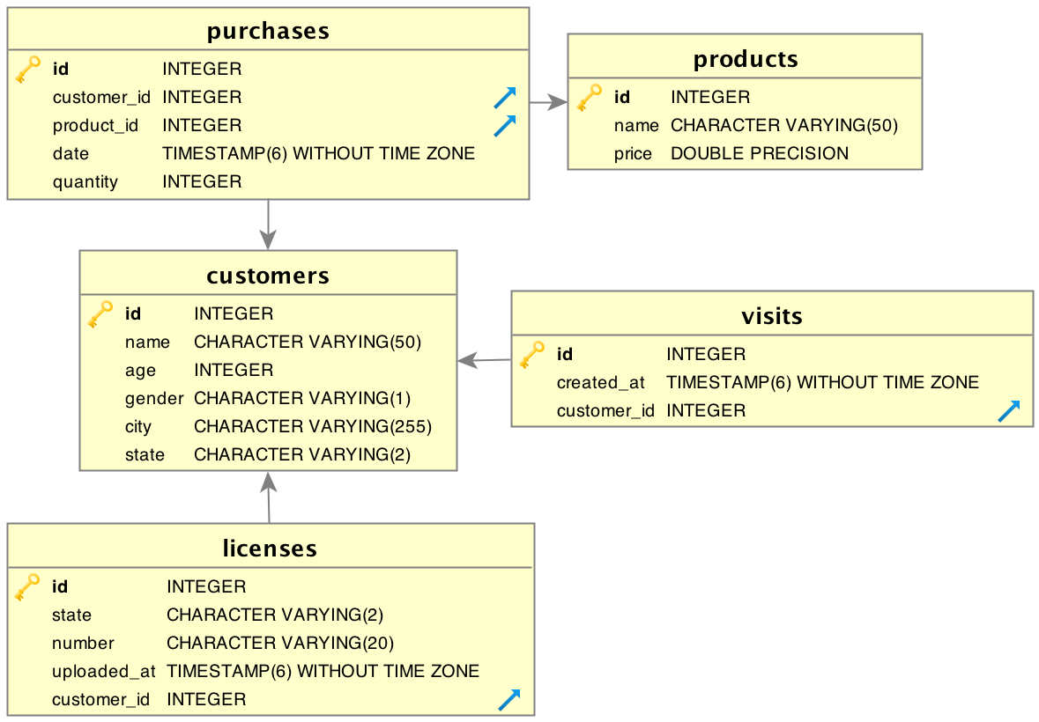
Why RDBMS ?
An RDBMS provides the ability to
Model relations in data
Query data and their relations efficiently
Maintain data consistency and integrity
It will require a Data Model

Slide 6
RDBMS Data Model
Schema defines the structure of the data
The database is composed of a number of user-defined tables
Each table will have columns (aka fields) and rows (aka records)
A column is of a given data type
A row is an entry in a table with data for each column of that table

Slide 7
RDBMS and SQL
SQL is the language used to query relational databases
All RDBMS use SQL and the syntax and keywords are the same for the most part, across systems
SQL is used to interact with RDBMS, allowing you to create tables, alter tables, insert records, update records, delete records, and query records within and across tables.
Even non-relational databases like Hadoop usually have a SQL-like interface available.

Slide 8
Structured Query Language (SQL)
SQL is the tool we use to interact with RDBMS. We can use SQL commands to:
Create and Alter tables in a database
Insert, Update, and Delete records in tables
Query (SELECT) records within or across tables
The most critical skill for a Data Scientist--as opposed to a Data Engineer or Database Administrator--is to extract information from databases.
We will focus on writing queries in PostgreSQL, but all of the commands use similar vocabulary and syntax. (PostgreSQL syntax)

Slide 9
SQL Query Basics
SQL queries have three main components:
SELECT # What data (columns) do you want?
FROM # From what location (table) you want it?
WHERE # What data (rows) do you want?
Note: SQL queries always return tables.
Note: SQL is a declarative language, unlike Python, which is imperative. With a declarative language, you tell the machine what you want, instead of how, and it figures out the best way to do it for you.

Slide 10
Formatting SQL statements
Unlike Python, whitespace and capitalization do not matter (except for strings)
select column1, column2 from my_table;
Convention is to use ALL CAPS for keywords
Line breaks and indentation help make queries more readable (especially complex ones)
SELECT
column1,
column2
FROM
my_table;
Punctuation such as commas (between items under each clause) and semicolons (after each statement) are required for proper evaluation

Slide 11
SELECT *
TABLE(S)
customers
cust_id | cust_name | cust_state
1 | Kayla | CO
2 | Erich | CO
3 | Adam | NY
4 | Frank | AZ

Slide 12
SELECT *
TABLE(S)
QUERY
customers
cust_id | cust_name | cust_state
1 | Kayla | CO
2 | Erich | CO
3 | Adam | NY
4 | Frank | AZ
SELECT
*
FROM
customers;
The asterisk means “everything.”

Slide 13
SELECT *
TABLE(S)
QUERY
OUTPUT
customers
cust_id | cust_name | cust_state
1 | Kayla | CO
2 | Erich | CO
3 | Adam | NY
4 | Frank | AZ
cust_id | cust_name | cust_state
1 | Kayla | CO
2 | Erich | MA
3 | Adam | NY
4 | Frank | AZ
SELECT
*
FROM
customers;
The asterisk means “everything.”

Slide 14
Aliases
TABLE(S)
QUERY
OUTPUT
customers
cust_id | cust_name | cust_state
1 | Kayla | CO
2 | Erich | CO
3 | Adam | NY
4 | Frank | AZ
SELECT
cust_name AS name,
cust_state state
FROM
customers;
name | state
Kayla | CO
Erich | CO
Adam | NY
Frank | AZ
Aliasing can be used to rename columns and even tables (more on this later).
“AS” makes code clearer but is not necessary.
Be careful not to use keywords (e.g. count) as aliases!

Slide 15
WHERE
TABLE(S)
QUERY
OUTPUT
customers
SELECT
cust_name AS name,
cust_state AS state
FROM
customers
WHERE
cust_state = ‘CO’;
cust_id | cust_name | cust_state
1 | Kayla | CO
2 | Erich | CO
3 | Adam | NY
4 | Frank | AZ
name | state
Kayla | CO
Erich | CO
WHERE specifies criterion for selecting specific rows (row filter)
Note that the WHERE statement must reference the original column name, not the alias
However, WHERE can reference a table column that is not in SELECT (e.g. cust_id)

Slide 16
WHERE (Multiple Criteria)
TABLE(S)
QUERY
OUTPUT
customers
SELECT
cust_name AS name,
cust_state AS state
FROM
customers
WHERE
(cust_state = ‘CO’
AND cust_name = ‘Kayla’)
OR cust_state = ‘NY’;
cust_id | cust_name | cust_state
1 | Kayla | CO
2 | Erich | CO
3 | Adam | NY
4 | Frank | AZ
name | state
Kayla | CO
Adam | NY
We can specify multiple conditions on the “WHERE” clause by using AND/OR
Note that comparison operator uses a single equal sign ( = instead of == )

Slide 17
LIMIT and ORDER BY
TABLE(S)
QUERY
OUTPUT
customers
SELECT
*
FROM
customers
ORDER BY
cust_name DESC
LIMIT 3;
cust_id | cust_name | cust_state
1 | Kayla | CO
2 | Erich | CO
3 | Adam | NY
4 | Frank | AZ
cust_id | cust_name | cust_state
1 | Kayla | CO
4 | Frank | AZ
2 | Erich | CO
ORDER BY is ascending by default; specify DESC for reverse sorting
LIMIT specifies the number of records returned

Slide 18
SELECT DISTINCT
TABLE(S)
QUERY
OUTPUT
customers
cust_id | cust_name | cust_state
1 | Kayla | CO
2 | Erich | CO
3 | Adam | NY
4 | Frank | AZ
SELECT DISTINCT
cust_state
FROM
customers;
cust_state
CO
NY
AZ
SELECT DISTINCT grabs all the unique records.
If multiple columns are selected, then all unique combinations are returned.

Slide 19
CASE WHEN
TABLE(S)
QUERY
OUTPUT
customers
SELECT
cust_name AS name,
CASE WHEN cust_state = ‘CO’ THEN 1
ELSE 0 END AS in_state
FROM
customers;
name | in_state
Kayla | 1
Erich | 1
Adam | 0
Frank | 0
cust_id | cust_name | cust_state
1 | Kayla | CO
2 | Erich | CO
3 | Adam | NY
4 | Frank | AZ
CASE WHEN statement is the SQL version of an if-then-else statement
Used in the SELECT clause
Can combine multiple WHEN statements and/or multiple conditionals

Slide 20
Aggregators
TABLE(S)
QUERY
OUTPUT
products
SELECT
COUNT(*),
MAX(price)
FROM
products;
prod_id | description | price
1 | skis | 300
2 | goggles | 75
3 | snowboard | 400
COUNT | MAX
3 | 400
Aggregators combine information from multiple rows into a single row.
Other aggregators include MIN, MAX, SUM, COUNT, STDDEV, etc.

Slide 21
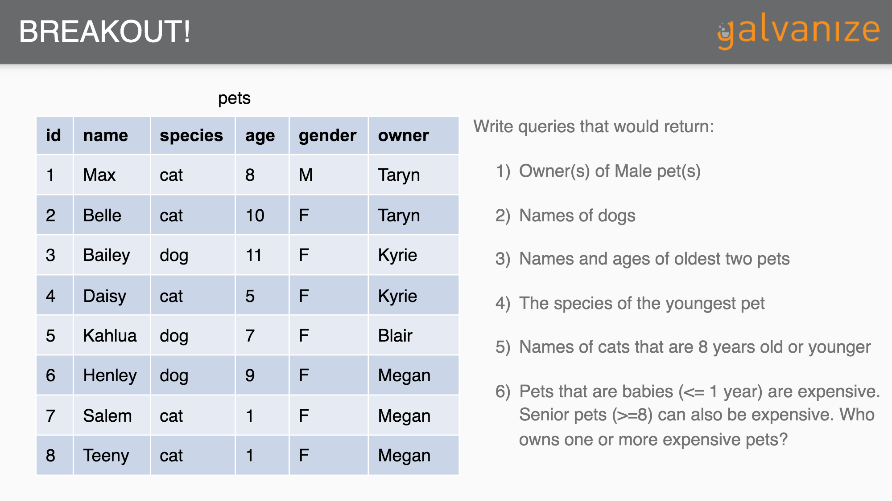
Breakout #1
Using:
a text editor (to write and save your queries)
Terminal (to run PostgreSQL)
Schema and Data from
Introduction to SQL for Data Scientists by Ben Smith
Answer:
Queries 0, 1, 2, and 3 in queries.sql

Slide 22
GROUP BY
TABLE(S)
QUERY
OUTPUT
customers
cust_id | cust_name | cust_state
1 | Kayla | CO
2 | Erich | CO
3 | Adam | NY
4 | Frank | AZ
SELECT
cust_state as state,
count(*)
FROM
customers
GROUP BY
cust_state;
state | count(*)
CO | 2
NY | 1
AZ | 1
The GROUP BY clause calculates aggregate statistics for groups of data
Any column that is not an aggregator must be in the GROUP BY clause (for example, if we added cust_name to the SELECT clause only, SQL would not know whether to return Kayla or Erich in the CO row)
Any column in the GROUP BY by clause must also appear in the SELECT clause (true of Postgres but not MySQL)

Slide 23
GROUP BY and WHERE
TABLE(S)
QUERY
OUTPUT
customers
cust_id | cust_name | cust_state
1 | Kayla | CO
2 | Erich | CO
3 | Adam | NY
4 | Frank | AZ
SELECT
cust_state AS state,
COUNT(*) AS total
FROM
customers
WHERE
cust_name != ‘Adam’
GROUP BY
cust_state;
state | total
CO | 2
AZ | 1

Slide 24
GROUP BY and WHERE (cont’d)
TABLE(S)
QUERY
OUTPUT
customers
cust_id | cust_name | cust_state
1 | Kayla | CO
2 | Erich | CO
3 | Adam | NY
4 | Frank | AZ
SELECT
cust_state AS state,
COUNT(*) AS total
FROM
customers
WHERE
COUNT(*) >= 2
GROUP BY
cust_state;
state | total
CO | 2
ERROR
Why does the query above not work?

Slide 25
GROUP BY and HAVING
TABLE(S)
QUERY
OUTPUT
customers
SELECT
cust_state AS state,
COUNT(*) AS total
FROM
customers
WHERE
count(*) >= 2
GROUP BY
cust_state
HAVING
COUNT(*) >= 2;
cust_id | cust_name | cust_state
1 | Kayla | CO
2 | Erich | CO
3 | Adam | NY
4 | Frank | AZ
state | total
CO | 2
Use HAVING instead of WHERE when filtering rows after aggregation
WHERE clause filters rows in the root table before aggregation
Like WHERE clause, HAVING clause cannot reference an alias (in Postgres, at least)

Slide 26
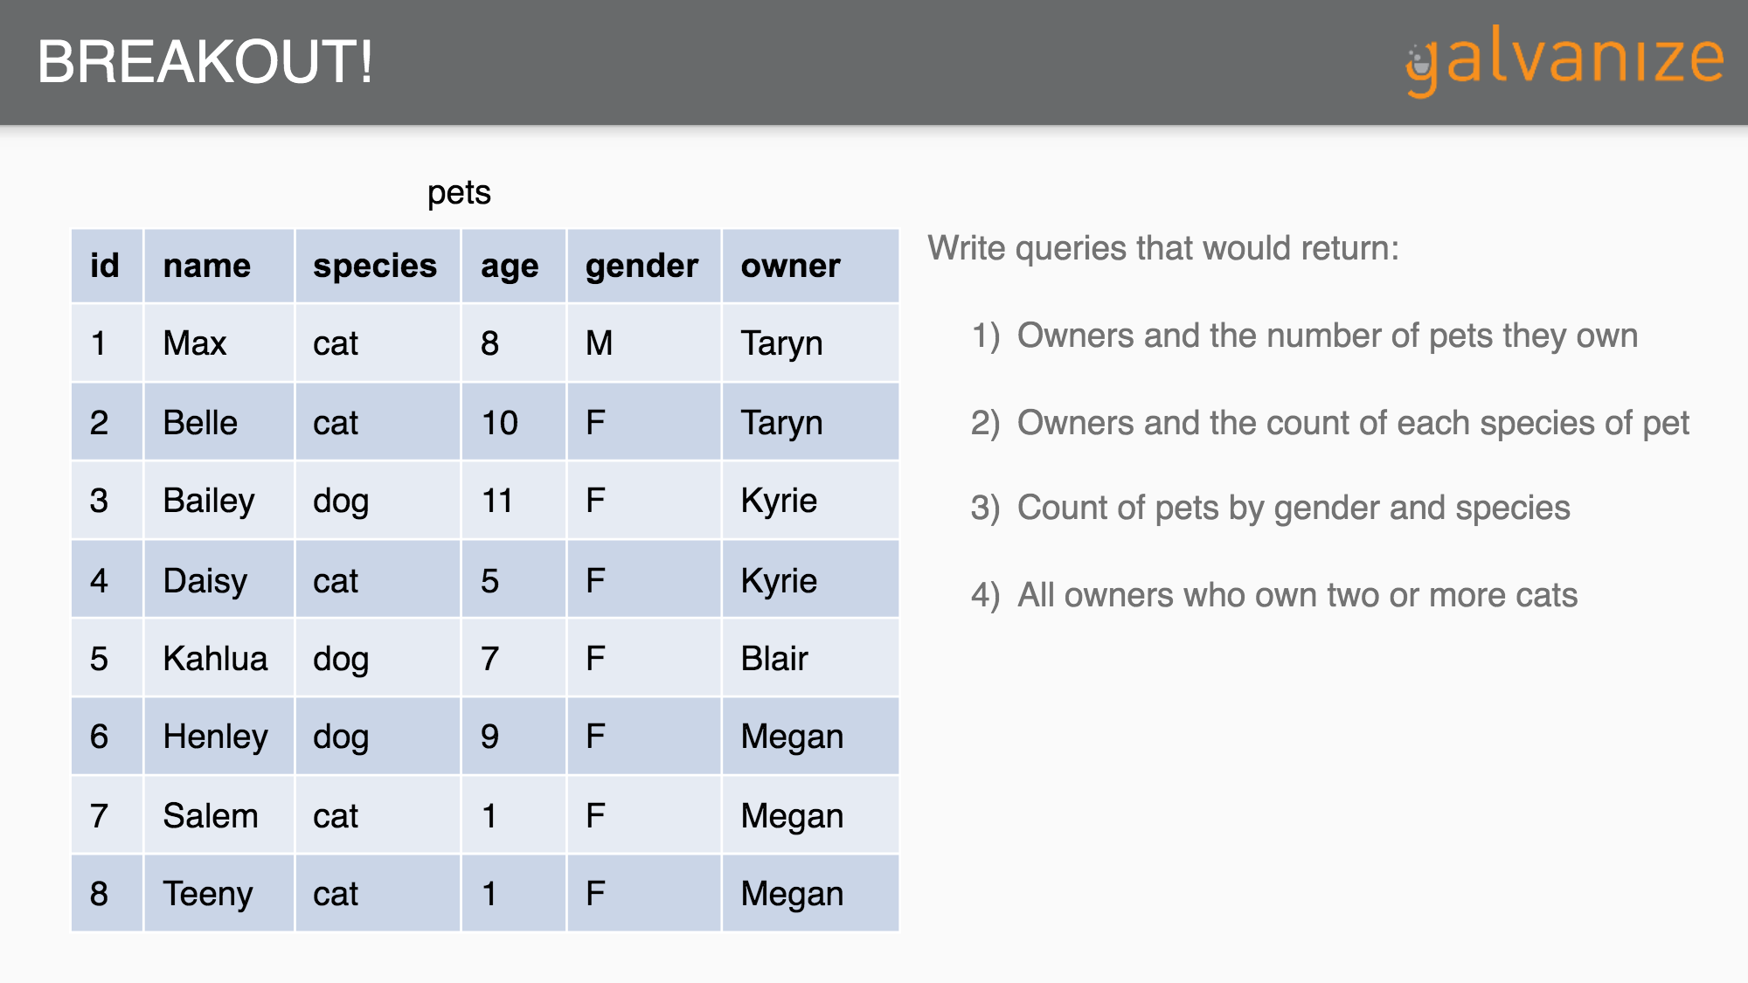
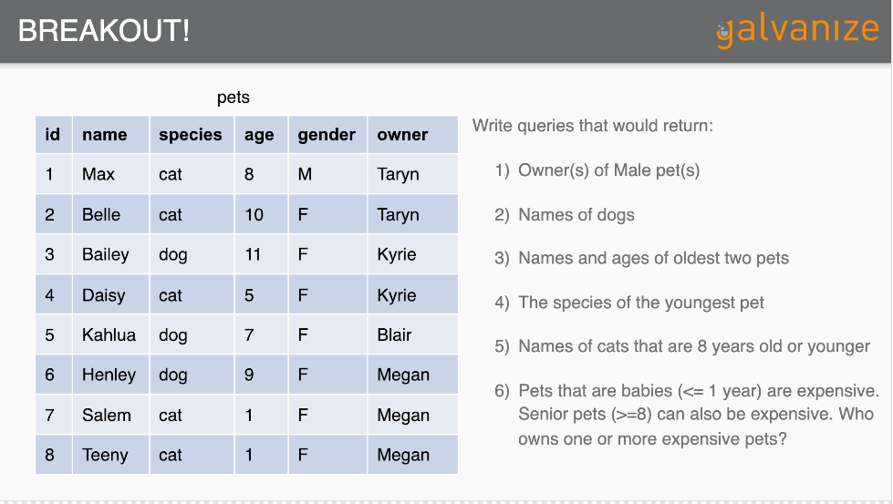
Breakout #2
Using:
a text editor (to write and save your queries)
Terminal (to run PostgreSQL)
Schema and Data from
Introduction to SQL for Data Scientists by Ben Smith
Answer:
Queries 4, 5, 6 and 7 in queries.sql

Slide 27
JOINs
purchases
purch_id | cust_id | prod_id | date
1 | 1 | 1 | 10/30
2 | 1 | 2 | 11/14
3 | 2 | 3 | 11/18
4 | 3 | 1 | 12/11
5 | 4 | 1 | 12/19
6 | 3 | 2 | 12/24
QUERY
OUTPUT
SELECT
purchases.purch_id,
customers.cust_id,
customers.cust_state
FROM
purchases
JOIN
customers
ON
purchases.cust_id = customers.cust_id;
purch_id | cust_id | cust_state
1 | 1 | CO
2 | 1 | CO
3 | 2 | CO
4 | 3 | NY
5 | 4 | AZ
6 | 3 | NY
customers
cust_id | cust_name | cust_state
1 | Kayla | CO
2 | Erich | CO
3 | Adam | NY
4 | Frank | AZ

Slide 28
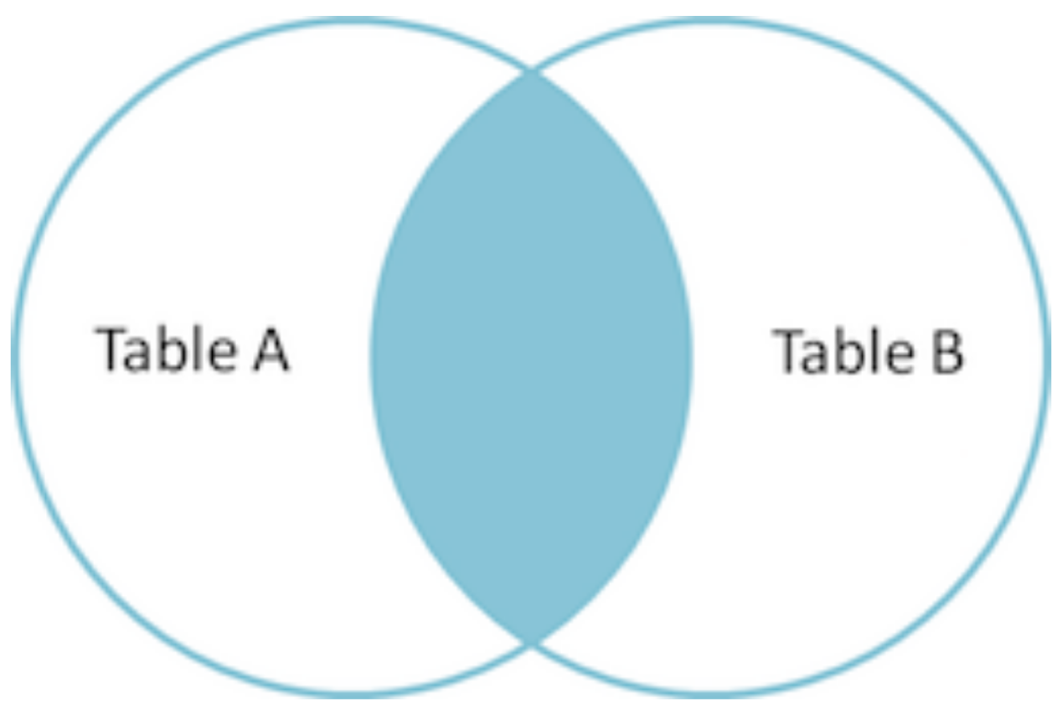
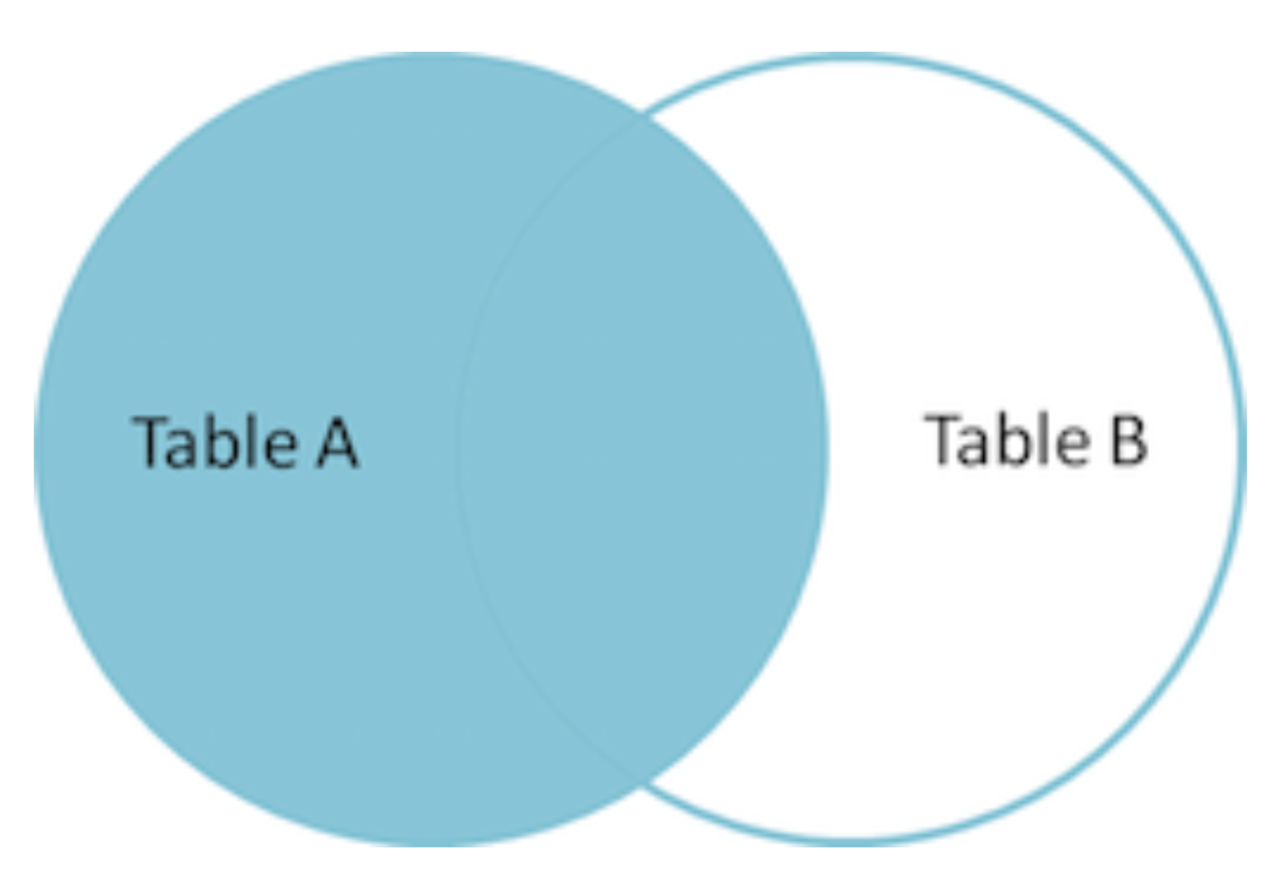
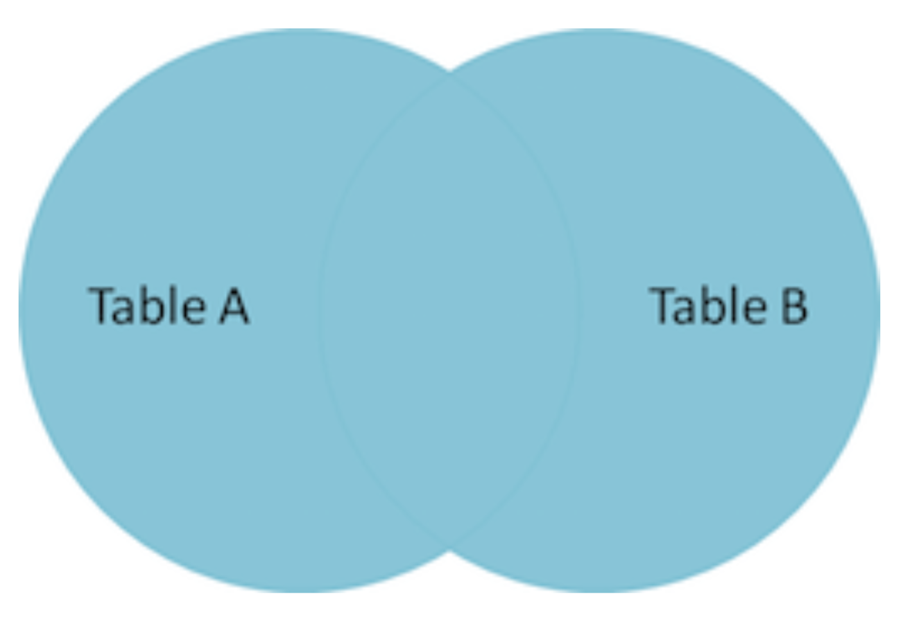
JOIN Types
SELECT … FROM TableA ____ JOIN TableB ON…
(INNER) JOIN: Discards any entries that do not have match between the keys specified in the ON clause. No null/nan values.
LEFT (OUTER) JOIN: Keeps all entries in the left (FROM) table, regardless of whether any matches are found in the right (JOIN) tables. Some null/nan values.
  RIGHT (OUTER) JOIN: Is the same, except keeps all entries in the right (JOIN) table instead of the left (FROM) table); usually avoided because it does the same thing as a LEFT join
FULL (OUTER) JOIN: Keeps the rows in both tables no matter what. More null/nan values.

Slide 29
(INNER) JOIN
purchases
purch_id | cust_id | prod_id | date
1 | 1 | 1 | 10/30
2 | 1 | 2 | 11/14
3 | 2 | 3 | 11/18
4 | 3 | 1 | 12/11
5 | NULL | 1 | 12/19
6 | NULL | 2 | 12/24
QUERY
OUTPUT
SELECT
purchases.purch_id,
customers.cust_id,
customers.cust_state
FROM
purchases
INNER JOIN
customers
ON
purchases.cust_id = customers.cust_id;
purch_id | cust_id | cust_state
1 | 1 | CO
2 | 1 | CO
3 | 2 | CO
4 | 3 | NY
customers
cust_id | cust_name | cust_state
1 | Kayla | CO
2 | Erich | CO
3 | Adam | NY
4 | Frank | AZ
5 | Neil | NY
INNER JOIN discards records that do not have a match in both tables

Slide 30
LEFT (OUTER) JOIN
purchases
purch_id | cust_id | prod_id | date
1 | 1 | 1 | 10/30
2 | 1 | 2 | 11/14
3 | 2 | 3 | 11/18
4 | 3 | 1 | 12/11
5 | NULL | 1 | 12/19
6 | NULL | 2 | 12/24
QUERY
OUTPUT
SELECT
purchases.purch_id,
customers.cust_id,
customers.cust_state
FROM
purchases
LEFT OUTER JOIN
customers
ON
purchases.cust_id = customers.cust_id;
purch_id | cust_id | cust_state
1 | 1 | CO
2 | 1 | CO
3 | 2 | CO
4 | 3 | NY
5 | NULL | NULL
6 | NULL | NULL
customers
cust_id | cust_name | cust_state
1 | Kayla | CO
2 | Erich | CO
3 | Adam | NY
4 | Frank | AZ
5 | Neil | NY
LEFT OUTER JOIN retains all records from the left (FROM) tables and includes records from the right (JOIN) table if they are available

Slide 31
FULL (OUTER) JOIN
purchases
purch_id | cust_id | prod_id | date
1 | 1 | 1 | 10/30
2 | 1 | 2 | 11/14
3 | 2 | 3 | 11/18
4 | 3 | 1 | 12/11
5 | NULL | 1 | 12/19
6 | NULL | 2 | 12/24
QUERY
OUTPUT
SELECT
purchases.purch_id,
customers.cust_id,
customers.cust_state
FROM
purchases
FULL OUTER JOIN
customers
ON
purchases.cust_id = customers.cust_id;
purch_id | cust_id | cust_state
1 | 1 | CO
2 | 1 | CO
3 | 2 | CO
4 | 3 | NY
5 | NULL | NULL
6 | NULL | NULL
NULL | 4 | AZ
NULL | 5 | NY
customers
cust_id | cust_name | cust_state
1 | Kayla | CO
2 | Erich | CO
3 | Adam | NY
4 | Frank | AZ
5 | Neil | NY
FULL OUTER JOIN retains all records from both tables regardless of matches

Slide 32
Subqueries
In general, you can replace any table name with a subquery:
SELECT … FROM (SELECT …)
If a query returns a single value, you can use it as such:
… WHERE column1 = (SELECT …)
If a query returns a single column, you can treat it like a vector:
…. WHERE column1 IN (SELECT …)

Slide 33
Subquery motivation
call_history
caller_id | receiver_id | date
3 | 4 | 10/30
2 | 4 | 11/14
3 | 2 | 11/18
4 | 1 | 12/11
2 | 3 | 12/19
QUERY
OUTPUT
How many calls did each person make?
name | total_calls
Kayla | NULL
Erich | 2
Adam | 2
Frank | 1
customers
id | name
1 | Kayla
2 | Erich
3 | Adam
4 | Frank

Slide 34
Using a subquery
call_history
caller_id | receiver_id | date
3 | 4 | 10/30
2 | 4 | 11/14
3 | 2 | 11/18
4 | 1 | 12/11
2 | 3 | 12/19
QUERY
OUTPUT
How many calls did each person make?
SELECT
customers.name,
calls_made.total_calls
FROM
customers
LEFT OUTER JOIN
(SELECT
caller_id,
count(*) AS total_calls
FROM call_history
GROUP BY caller_id
) AS calls_made
ON
customers.id = calls_made.caller_id;
name | total_calls
Kayla | NULL
Erich | 2
Adam | 2
Frank | 1
customers
id | name
1 | Kayla
2 | Erich
3 | Adam
4 | Frank
Again, aliasing a subquery allows us to refer to it after creation (in ON clause).

Slide 35
Another way: Common Table Expressions
Or: The With Clause
call_history
caller_id | receiver_id | date
3 | 4 | 10/30
2 | 4 | 11/14
3 | 2 | 11/18
4 | 1 | 12/11
2 | 3 | 12/19
QUERY
OUTPUT
WITH calls_made AS
(SELECT
caller_id,
count(*) AS total_calls
FROM call_history
GROUP BY caller_id)
SELECT
customers.name,
calls_made.total_calls
FROM
customers
LEFT OUTER JOIN
calls_made
ON
customers.id = calls_made.caller_id;
How many calls did each person make?
customers
name | total_calls
Kayla | NULL
Erich | 2
Adam | 2
Frank | 1
id | name
1 | Kayla
2 | Erich
3 | Adam
4 | Frank
A single temporary table can be used in place of multiple identical subqueries.

Slide 36
Subquery vs Temp Table vs Create/Drop Table
All three approaches yield the same results. The best one might depend on how many times you will reference newTable. And which are the most readable?
SELECT
newTable.col1,
newTable.col2
FROM
(SELECT
col1,
col2,
col3
FROM
anotherTable
) AS newTable;
WITH newTable AS
(SELECT
col1,
col2,
col3
FROM
anotherTable)
SELECT
newTable.col1,
newTable.col2
FROM
newTable;
CREATE TABLE newTable AS
(SELECT
col1,
col2,
col3
FROM
anotherTable);
SELECT
newTable.col1,
newTable.col2
FROM
newTable;
DROP TABLE newTable;

Slide 37
Subquery vs Temp Table vs Create/Drop Table
All three approaches yield the same results. The best one might depend on how many times you will reference newTable. And which are the most readable?
SELECT
newTable.col1,
newTable.col2
FROM
(SELECT
col1,
col2,
col3
FROM
anotherTable
) AS newTable;
WITH newTable AS
(SELECT
col1,
col2,
col3
FROM
anotherTable)
SELECT
newTable.col1,
newTable.col2
FROM
newTable;
CREATE TABLE newTable AS
(SELECT
col1,
col2,
col3
FROM
anotherTable);
SELECT
newTable.col1,
newTable.col2
FROM
newTable;
DROP TABLE newTable;
In memory (if small enough),
dropped at end-of-session
written to hard disk

Slide 38
And you can have more than 1 Temp Table via the With Clause
WITH newTable1 AS
(SELECT
col1
FROM
anotherTable),
newTable2 AS
(SELECT
col1
FROM
anotherTable2)
SELECT
newTable1.col1 AS alias1
newTable2.col1 AS alias2

Slide 39
Another way: The View.
A view functions like a table, but is created dynamically via a select statement
call_history
caller_id | receiver_id | date
3 | 4 | 10/30
2 | 4 | 11/14
3 | 2 | 11/18
4 | 1 | 12/11
2 | 3 | 12/19
QUERY
OUTPUT
CREATE VIEW VW_calls_made AS
(SELECT
caller_id,
count(*) AS total_calls
FROM call_history
GROUP BY caller_id)
SELECT
customers.name,
calls_made.total_calls
FROM
customers
LEFT OUTER JOIN
calls_made
ON
customers.id = calls_made.caller_id;
How many calls did each person make?
customers
name | total_calls
Kayla | NULL
Erich | 2
Adam | 2
Frank | 1
id | name
1 | Kayla
2 | Erich
3 | Adam
4 | Frank
While creating a table stores a new table in memory, and a CTE/With Clause holds the table in memory, A view stays in the database until it is removed, and populates dynamically when it is accessed

Slide 40
Window Functions
call_history
caller_id | receiver_id | date
3 | 4 | 10/30
2 | 4 | 11/14
3 | 2 | 11/18
4 | 1 | 12/11
2 | 3 | 12/19
Like an Aggregation function, but what if we don't want to reduce the number of rows, but still want to see the aggregation for each row? We can use an OVER clause in conjunction with an aggregation function (for instance, AVG()) to do this.We can modify the window that the aggregation occurs on by adding PARTITION BY into the OVER clause.
OUTPUT
Identifying the most recent call for each customer
customers
QUERY
id | name
1 | Kayla
2 | Erich
3 | Adam
4 | Frank
name | row_num | date
Adam | 1 | 10/30
Adam | 2 | 11/18
Erich | 1 | 11/14
Erich | 2 | 12/19
Frank | 1 | 12/11
SELECT
Customers.name,
ROW_NUMBER() OVER(PARTITION ON customers.name OVER call_history.date) as row_num,
call_history.date
FROM
customers
LEFT OUTER JOIN
calls_made
ON
customers.id = calls_made.caller_id;
ORDER BY customer.name, row_num

Slide 41
SQL Best Practices
“I spent 2 years refactoring poorly running SQL queries for a major healthcare company with 18,000+ tables in its database (some with over a billion rows in it).
Here is what I learned.”
-- Jordan Hagan, DSI alumna

Slide 42
SQL Best Practices
Don't use SELECT * unless you are learning about the data and trying to see what is in a table.
  People used to cite performance issues as a main reason for this. With today's technology that is not totally true any more.
  But what is true is that SQL is already pretty slow, and no reason to make it pull in every column if you don't need them all.
  It has "code smell" which means it's not wrong, it's just not a best practice.
  It makes your code unreadable to anyone else skimming it (i.e... on GitHub).

Slide 43
SQL Best Practices
The most important line of any SQL query you will ever write is your "FROM" statement.
  Your FROM statement dictates how the rest of the code is going to be written.
    Joins that link back to the FROM table instead of other join tables run are much less computationally intensive because SQL is not running through all of FROM and all of the other tables to finally get the records it needs.
  I [Jordan] have never once had to write a RIGHT JOIN. If you have to, you can likely move that table to be your FROM table, and LEFT JOIN to the table you need to.
    Not that this really matters, it's just easier to read.
  Your FROM table should be a small-medium concise table. (i.e... a site directory).

Slide 44
SQL Best Practices
Do not make your joins in your WHERE statement.
SELECT
table1.this,
table2.that,
table2.somethingelse
FROM
table1, table2
WHERE
table1.foreignkey = table2.primarykey
AND (some other conditions)
It's a personal pet peeve [Jordan] but it also way more computationally intensive, and much harder to read.

Slide 45
SQL Best Practices
Don't use subselects (subqueries) if you can avoid it.
  Again, there are computational and readability reasons.
  Sometimes it’s necessary - but most of the time you can make it a temp table!
  Faster!
  Prettier!
  Easier to read!
Check out Jordan’s SQL code on Github.

Slide 46
SQL Best Practices
SQL isn't case sensitive - so make your code pretty.
  This is different for everyone!
  I [Jordan] have strong opinions on how "SELECT, CASE, WHEN, END, FROM, WHERE, ORDER BY, HAVING, and GROUP BY" should all be all capitalized. But that's just a personal preference.
  Some people like commas in the SELECT before the columns, I prefer them to all be after the column.
  Some people are crazy and like all their columns on one line, I like each one on it's own line.
Whatever you do, just be consistent!

Slide 47
SQL Best Practices
SELECT
table1.this
,table2.that
,table2.somethingelse
FROM table1
INNER JOIN table2 ON table1.foreignkey = table2.primarykey
WHERE table1.name LIKE ‘%smith%’
AND table2.city = ‘Denver’
OR
SELECT
tb1.this,
tb2.that,
tb2.somethingelse
FROM
table1 AS tb1
INNER JOIN
table2 AS tb2
ON
tb1.foreignkey = tb2.primarykey
WHERE
tb1.name LIKE ‘%smith%’
AND
table2.city = ‘Denver’
BUT MAYBE NOT
SELECT b.this, a.that, a.somethingelse
FROM table1 AS b, table2 AS a
WHERE b.foreignkey = a.primarykey
AND b.name LIKE ‘%smith%’
AND a.city = ‘Denver’

Slide 48
Objectives
Describe why we use Relational Database Management Systems (RDBMS)
Understand primary keys, foreign keys, and table relationships
Write simple SQL queries on a single table using SELECT, FROM, WHERE, GROUP BY, ORDER BY clauses as well as aggregation functions (COUNT, AVG, etc.)
Write more complex SQL queries using joins, subqueries, and temporary tables, CTEs and Views.
Learn how to use a window function
Discuss SQL best practices
Interact with a Postgres database from the command line
Learn how to say PostgreSQL (link)

Slide 49

Appendix
Instructions on Postgres installation and set-up are in the individual.md file
Postgres must be running in order to use it from the command line:
Instructions on loading the database and entering postgres prompt from the command line are also in the individual.md file
Look for ambiguous ungulate icon

Slide 50
PostGres Basics
Ways to use psql in the shell/term:
$ psql connects to postgres server
$ psql -U [USERNAME] connects with given username
$ psql [DBNAME] connects to a given database
$ psql < script.sql reads file script.sql and send commands to psql
Try it live:
Open file sql/lecture_create.sql in atom
Use it to create a “dsilecture” database on your psql server

Slide 51
PostGres Basics
Useful psql commands at the prompt [link]:
# \h | SQL help
# \? | psql commands help
# \l | List all the tables in the database
# \d | Describe the table schema
# \d db_name | Describe tables for a specific db
# \connect db_name | Connects to a database
Try it live: Connect to “dsilecture” and describe schema of table “customer”

Slide 52
Load .sql file into a DB and run queries
One-time step to create a database and load .sql file. From the command line:
$ psql
# CREATE DATABASE MyDatabase;
# \q
$ psql MyDatabase < file.sql
Now you can access this database any time:
psql MyDataBase
Instructions on loading the database and entering postgres prompt from the command line are also in the individual.md file

Slide 53
Some Postgres commands
Useful commands from the psql interactive shell prompt:
\l - list all databases
\d - list all tables
\d <table name> - describe a table’s schema
\h <clause> - Help for SQL clause help
q - exit current view and return to command line
\q - quit psql
\i script.sql - run script (or query)

